Slide 1
Connecting to Classweb

Slide 2
Setup Instructions
Handouts, PowerPoint, and Support Information:
https://it.unt.edu/classweb-support

Slide 3
Connecting to Classweb
Personal Device

Slide 4
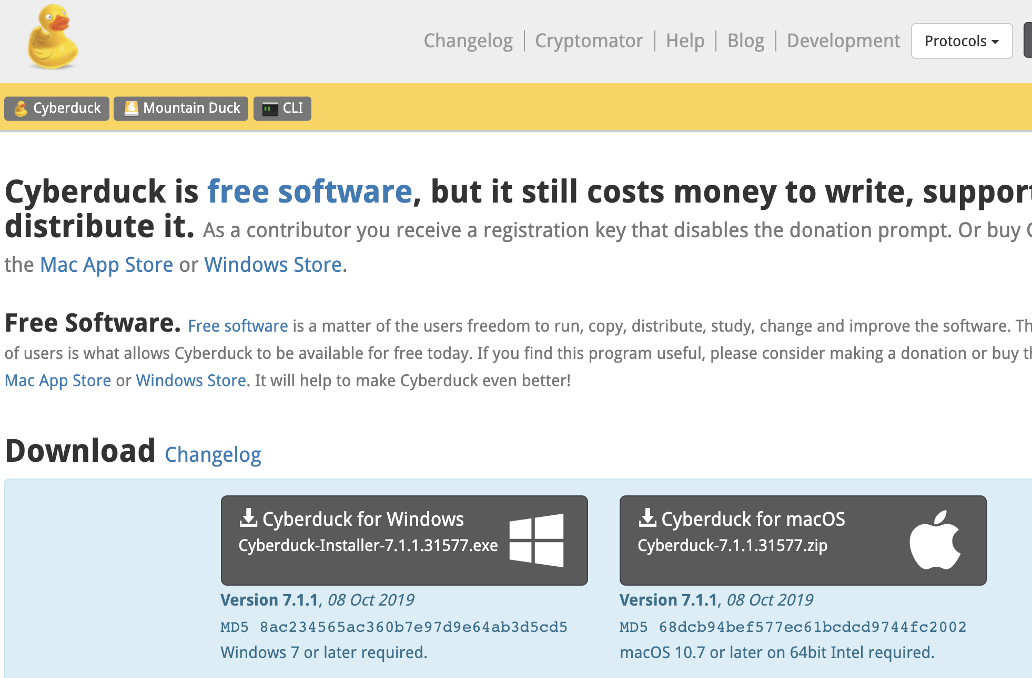
Installing Cyberduck
Visit cyberduck.io/download/
Download Corresponding Version for your Device

Slide 5
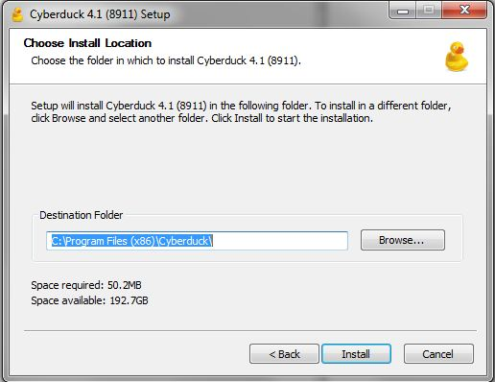
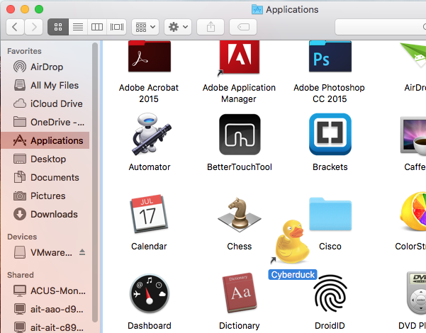
Installing Cyberduck
Windows
Double-Click the installation file
Go through the installation process
Mac
Double-Click the downloaded .zip file
Drag/Drop the Cyberduck application
to the Applications folder

Slide 6
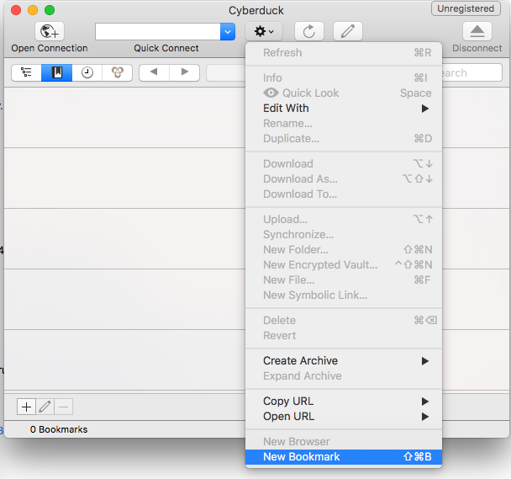
Connecting to Classweb
Open Cyberduck and Click “Action”. Then, click “New Bookmark”

Slide 7
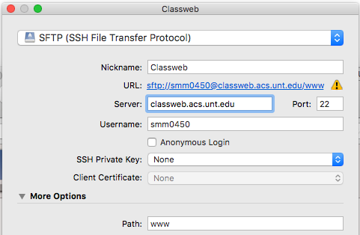
Connecting to Classweb
Enter these settings, then close the window

Slide 8
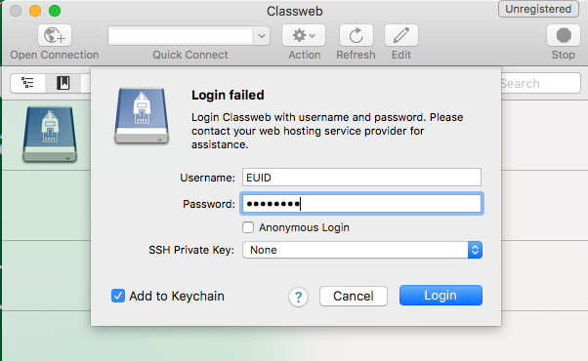
Connecting to Classweb
Double click the Classweb connection. When prompted, enter your password and click “Login”

Slide 9
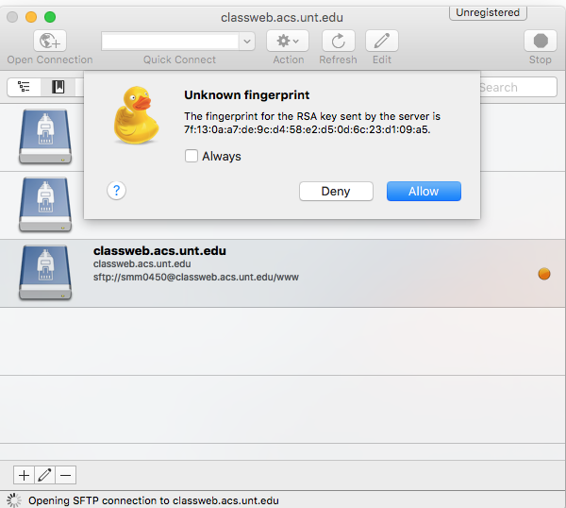
Connecting to Classweb
Allow Unknown Fingerprint

Slide 10
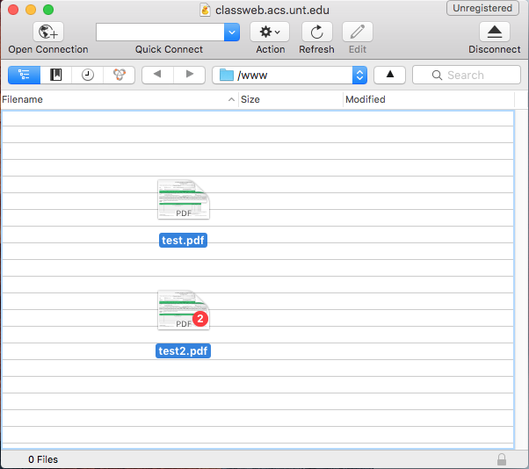
Connecting to Classweb
Drag/Drop Files As Needed

Slide 11
Accessing Classweb Online
In your browser, visit http://classweb.acs.unt.edu/classes/mktg4620001/
Click on your EUID to see the files uploaded to your folder, open your website, etc.

Slide 12
Connecting to Classweb
CoB Computer Labs or VMware

Slide 13
Opening WinSCP
Open the Coba Menu
Double click the icon below located on the Desktop

Slide 14
Opening WinSCP
Open the “Communications” folder, then double-click on WinSCP

Slide 15
Connecting to Classweb
Enter the following connection info and click “Advanced”:

Slide 16
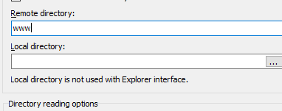
Connecting to Classweb
Under “Environment” click “Directories”
Type“www” in “Remote Directory”, click “OK”

Slide 17
Connecting to Classweb
Click “Login”

Slide 18
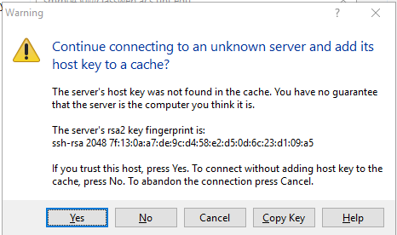
Connecting to Classweb
Allow Unknown Fingerprint

Slide 19
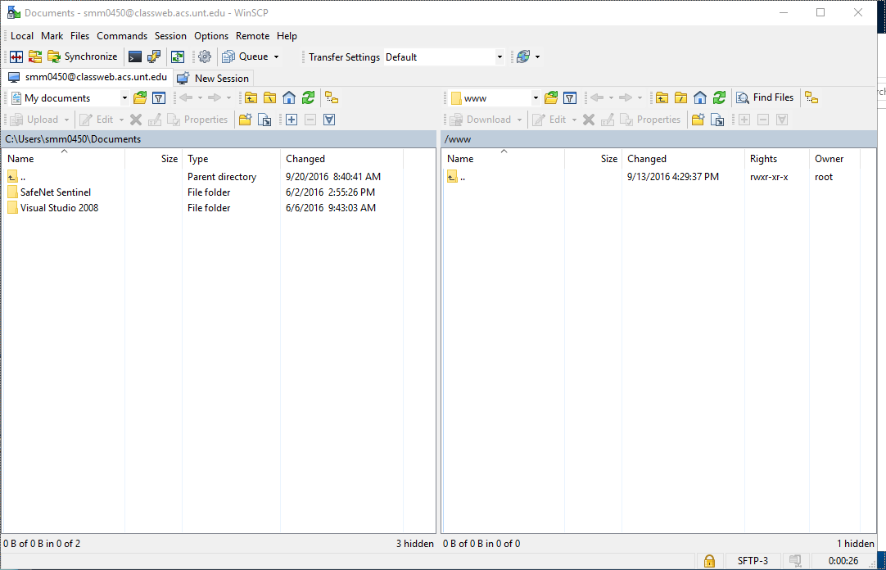
Connecting to Classweb
Drag/Drop Files Between Panes

Slide 20
Accessing Classweb Online
In your browser, visit http://classweb.acs.unt.edu/classes/mktg4620001/
Click on your EUID to see the files uploaded to your folder, open your website, etc.

Slide 21
Questions? Contact the UIT Help Desk
Contact Information:
https://www.it.unt.edu/classweb-support
Sage Hall - Room 330
940-565-2324 HelpDesk@unt.edu
Live Chat Now Available

